Slide 1
PH HSIR Improvements Program

Slide 2
Agenda
Work Completed
Upcoming Work
Impacts
Occupant Communication
Q & A
Notes:
High Level only. Julie will present this slide.

Slide 3
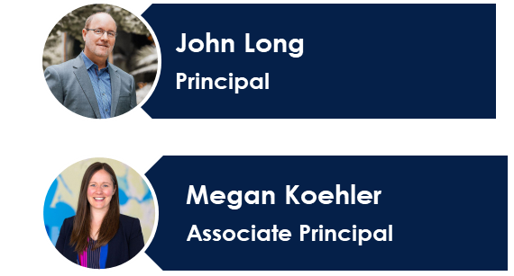
HSIR Improvements Team
Julie Gallivan
Senior Project Manager
Jason Felipe
Construction Manager
Sam Devetski
Senior Project Engineer
Helen Chung
Project Engineer
Monica Caporale
Project Management Analyst
Doug Bibby
Construction Manager & Project Controls
Ryan Miller
Senior Project Manager
Forrest Walch
Construction Manager
Mike Spillane
Senior Superintendent
David Rango
Senior Project Engineer
Yasser Fayek
Senior Project Engineer
Divyank Malviya
Project Engineer
Xinwen He
Project Engineer
Maraya Morgan
Project Architect

Slide 4
Program Goals & Benefits
Program Goals:
Improve the seismic performance to better than code minimum and seismically brace utilities within the buildings
Upgrade utilities within the seismic joints
Address the most critical life safety improvements by adding fire sprinklers throughout the HSIR buildings, adding fire sprinklers to chemical fume hoods, and correcting pipe pressure deficiencies
Completely repair exterior ledges and recoat with a new waterproofing system to improve longevity
Program Benefits:
Safer for employees in the event of a major seismic event
Labs and experiments will be better protected
Supporting UCSF’s mission of “Advancing Health Worldwide”
Notes:
High Level only. Julie will present this slide.

Slide 5
Project Timeline
Current Status
Milestone 1
Milestone 2
Milestone 3
UCSF Budget Approval
Physical Construction Start
Completion
Public Bid Process
Finish 05/13/22
Contract Submittals & Procurement
Start 09/19/22
Physical Construction
Start 01/07/23
UCSF UCOP
Finish 09/10/22
Investigations
Start 10/25/22
25% Completion
07/21/23
75% Completion
08/14/24
Project Completion
03/30/25
50% Completion
02/01/24
PreCon Stage
Investigations
Construction
Closeout
Notes:
Talk about the schedule going forward only.

Slide 6
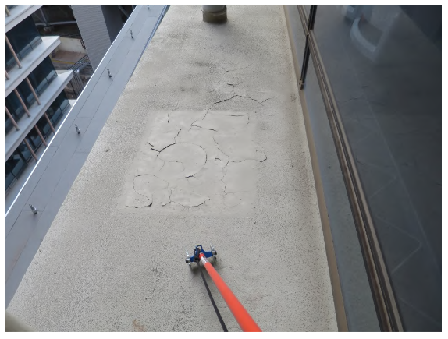
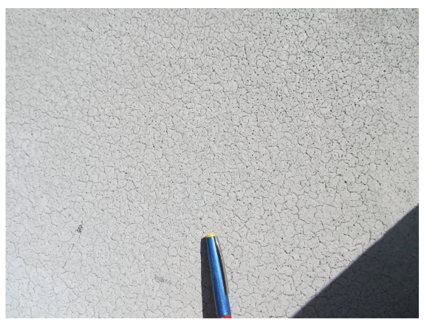
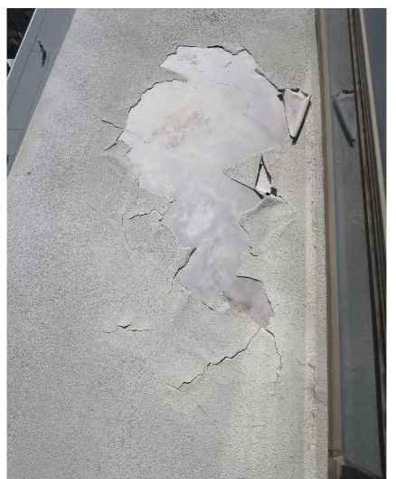
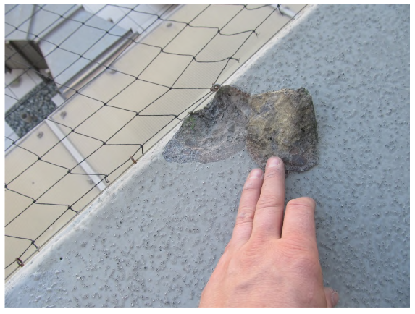
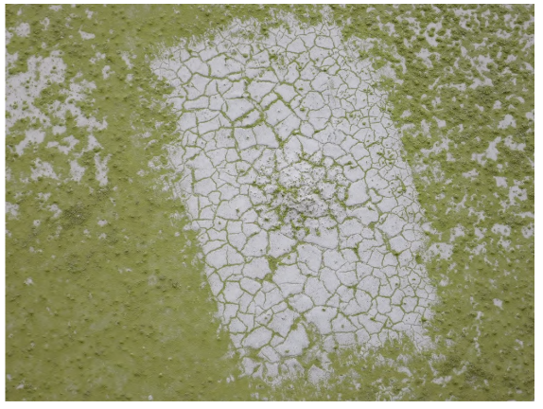
Exterior Repairs Project
Criteria for floor sequencing:
Lower floors are priority, as it has the critical utilities connections
Prioritizing upper floors most vulnerable during a seismic event
Cracked and Delaminated Traffic Coating
Notes:
showing examples of the existing conditions
typical cracked and delaminated traffic coating
you can see the concrete finish below failed coating
spalled concrete underlying the traffic coating
biological growth on traffic coating

Slide 7
Exterior Repairs Project
Criteria for floor sequencing:
Lower floors are priority, as it has the critical utilities connections
Prioritizing upper floors most vulnerable during a seismic event
Damaged Concrete Ledges
Notes:
showing examples of the existing conditions
typical cracked and delaminated traffic coating
you can see the concrete finish below failed coating
spalled concrete underlying the traffic coating
biological growth on traffic coating

Slide 8
Exterior Repairs Project
Criteria for floor sequencing:
Lower floors are priority, as it has the critical utilities connections
Prioritizing upper floors most vulnerable during a seismic event
Scaffold and Shrinkwrap Installation
Notes:
showing examples of the existing conditions
typical cracked and delaminated traffic coating
you can see the concrete finish below failed coating
spalled concrete underlying the traffic coating
biological growth on traffic coating

Slide 9
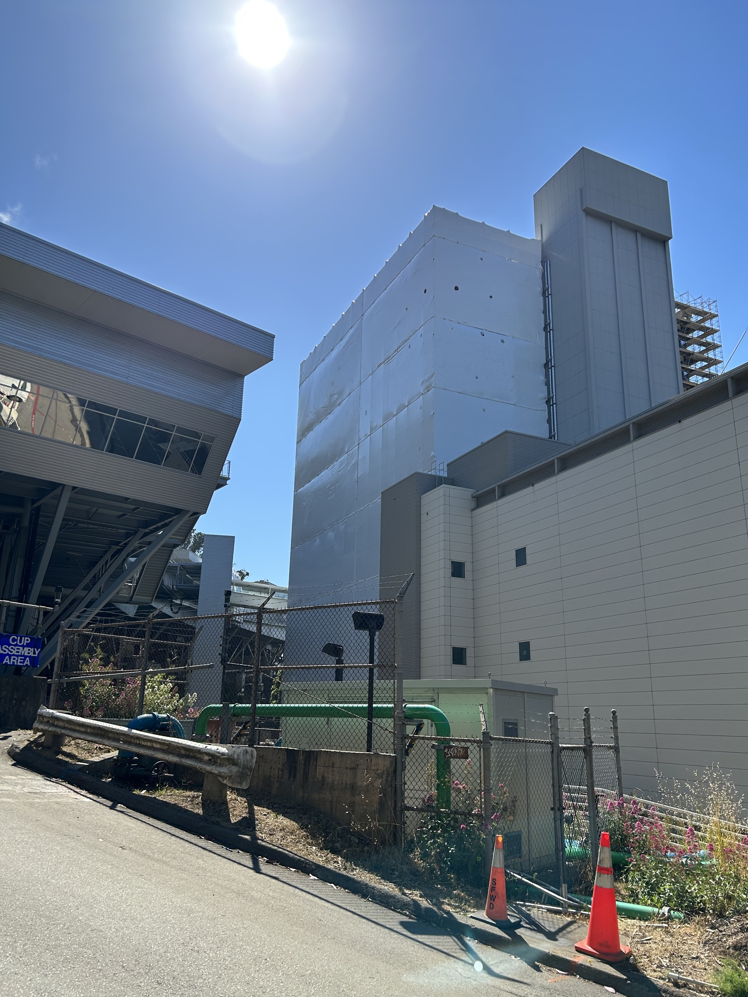
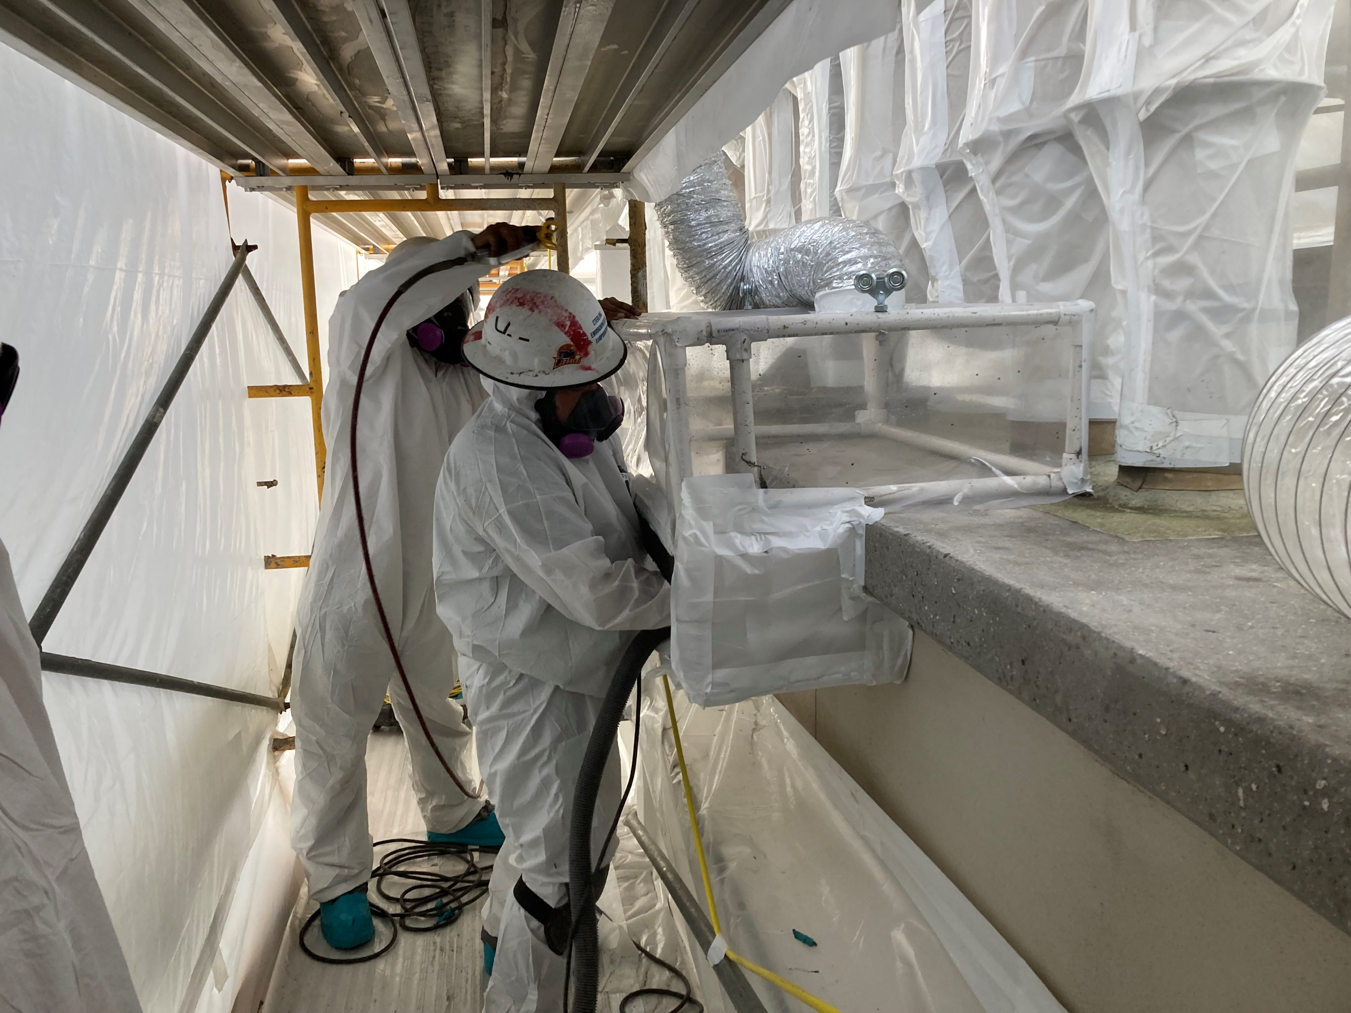
Exterior Repairs Project
Criteria for floor sequencing:
Lower floors are priority, as it has the critical utilities connections
Prioritizing upper floors most vulnerable during a seismic event
Abatement inside Shrinkwrap
High Impact Activity - Existing ledges contain Asbestos and to safely remove, there is a need for a contained space. The repair work will generate noise and vibration. Proper measure will be taken to minimize the impact as much as possible.
Notes:
showing examples of the existing conditions
typical cracked and delaminated traffic coating
you can see the concrete finish below failed coating
spalled concrete underlying the traffic coating
biological growth on traffic coating

Slide 10
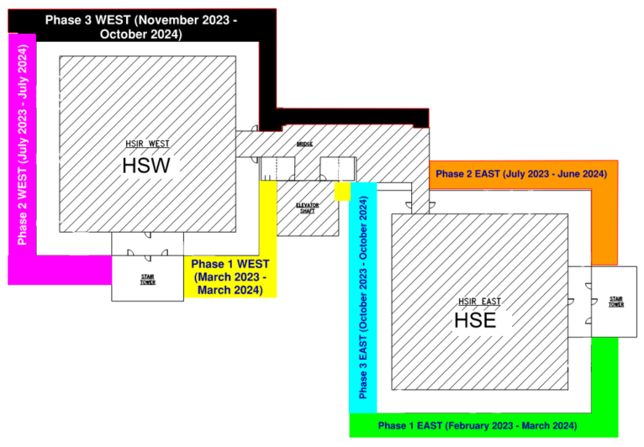
Shrink Wrap Installation and Removal Phases
Notes:
Explain in depth
Phasing of how the colors/phases progress and how we take them down. – WB to take lead and work on this.

Slide 11
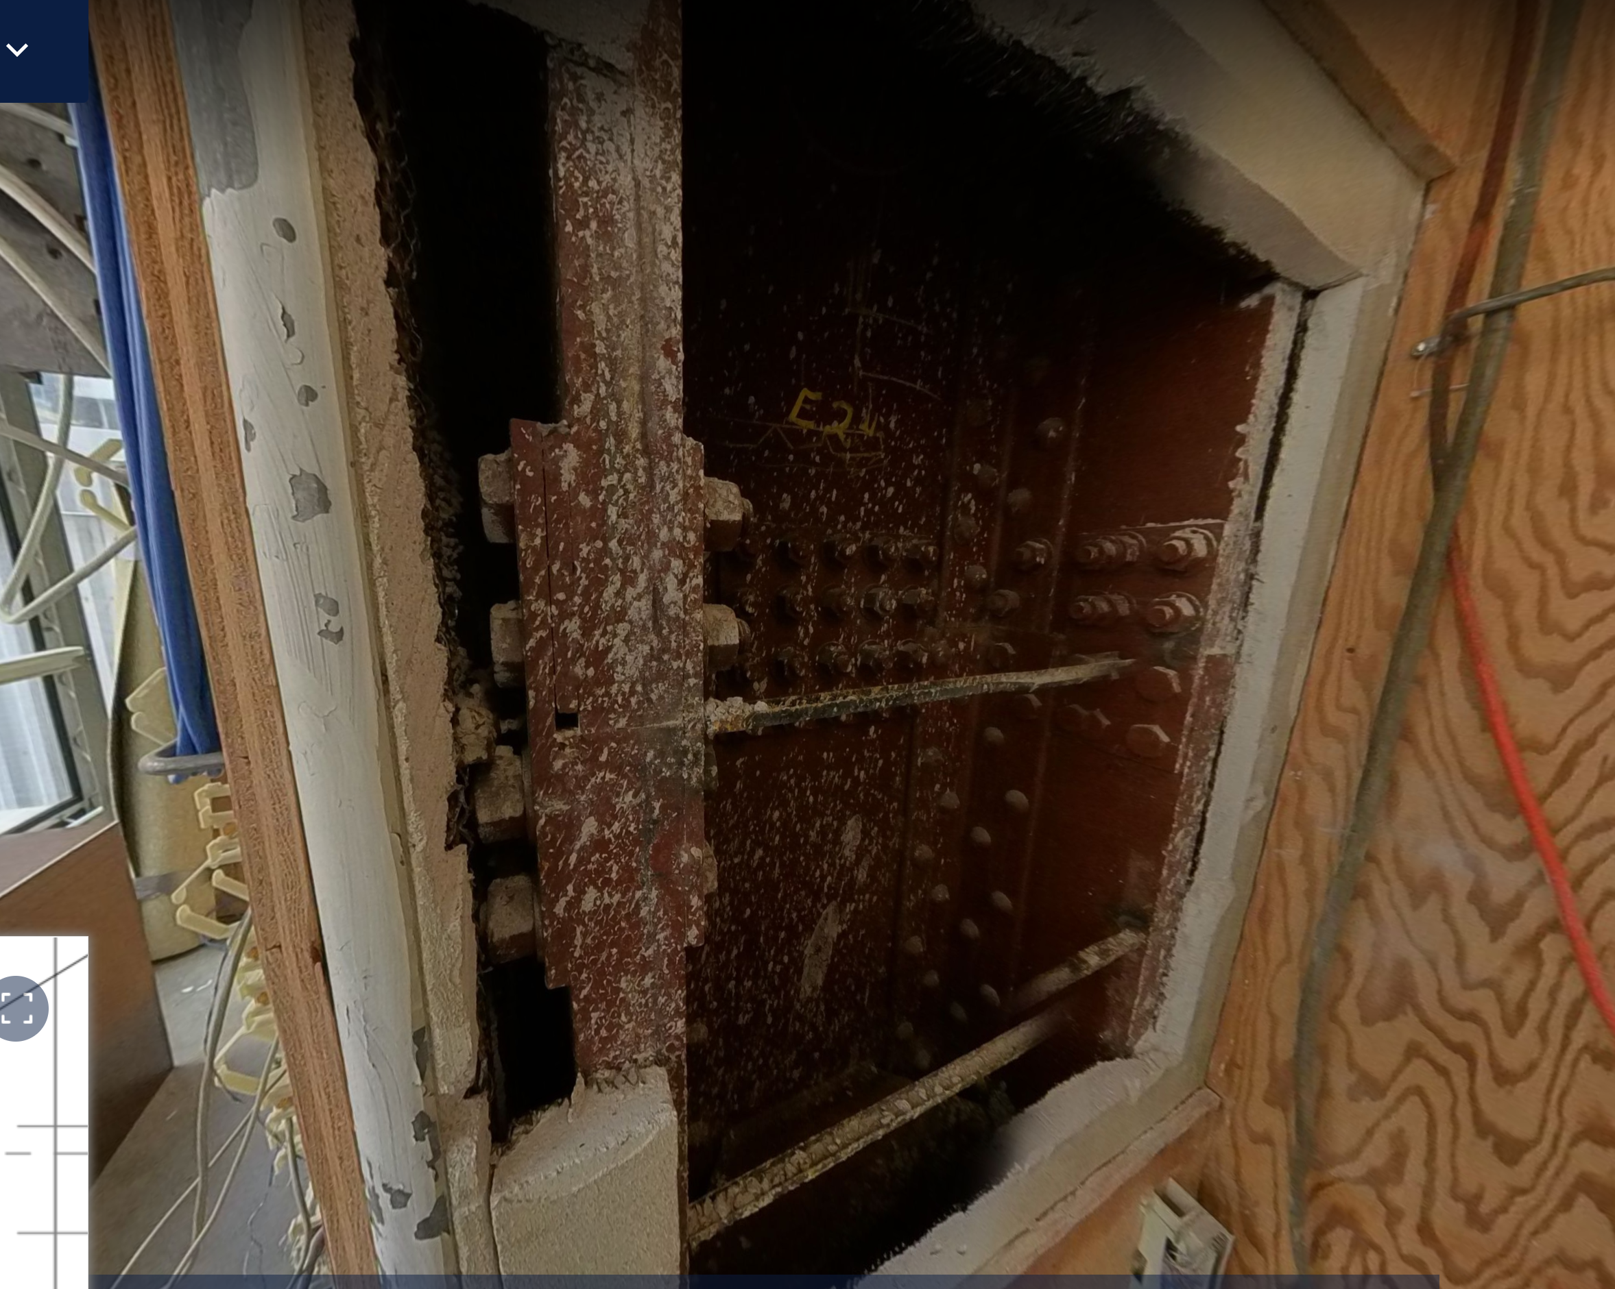
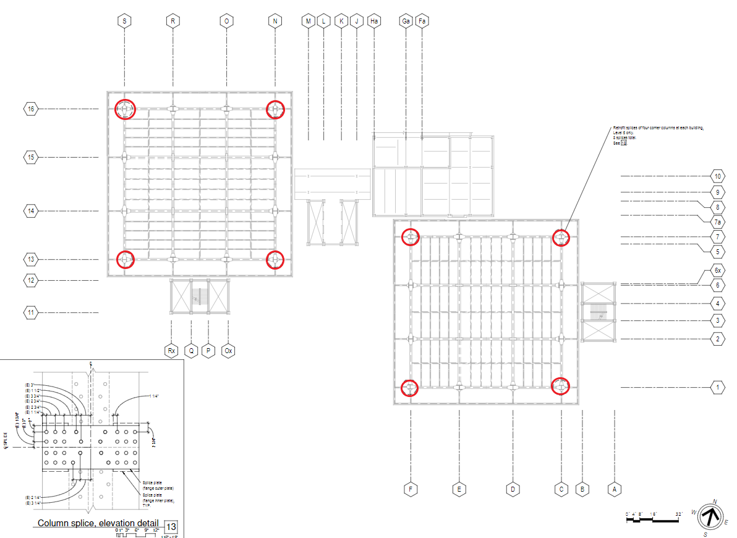
Column Splice Work
HSW 5
HSE 5
High Impact Activity - Existing structure has a splice in Level 5 and there is a need to replace the existing connections with Higher strength to enhance the structural integrity of the building

Slide 12
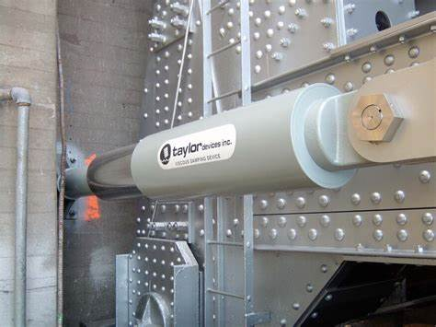
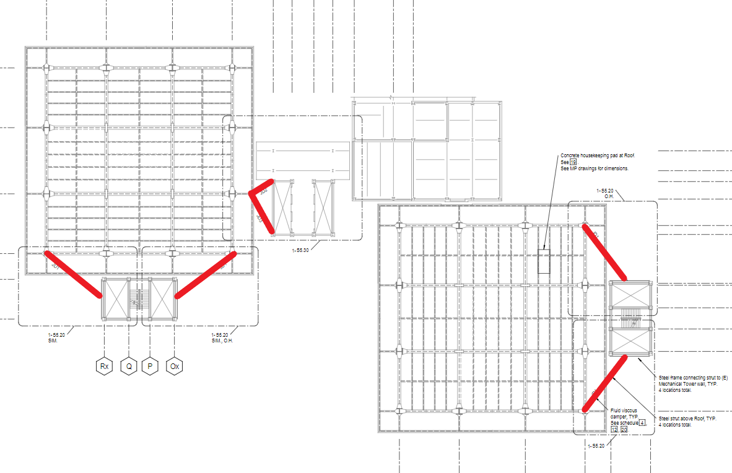
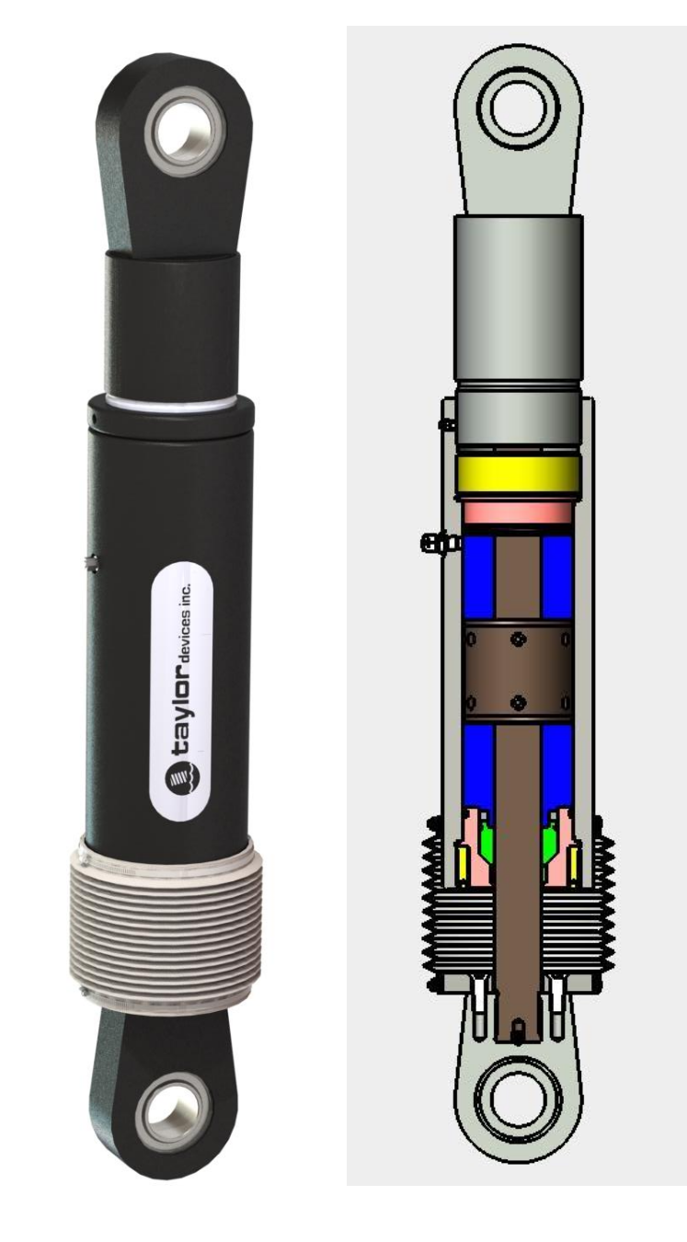
Joint Damper Locations
HSW
JD2
JD3
JD1
JD1
JD1
HSE
JD1 – 4 Dampers at Level 17 (Roof)
JD2 – 2 Dampers at Level 14 and 15
JD3 – 2 Dampers at Level 14 and 15
JD1
High Impact Activity - Intent is to tie-in the Elevator corridor and the stair tower to the main structure, so in case of a life-event, the structure will stay integrated.

Slide 13
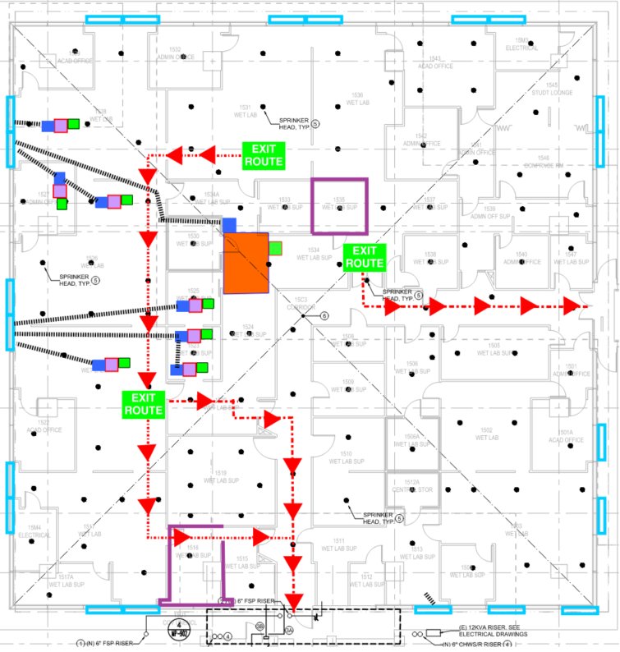
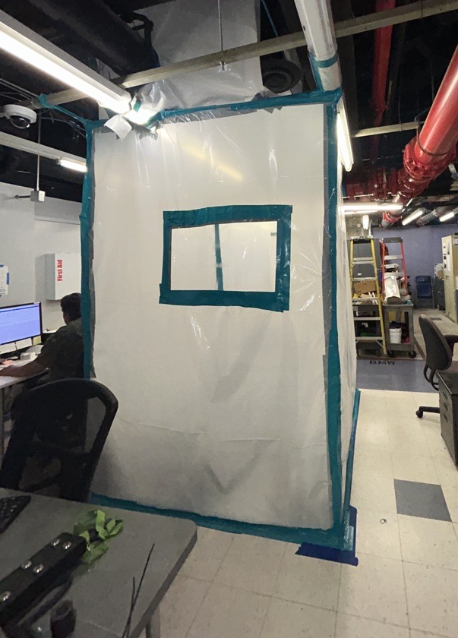
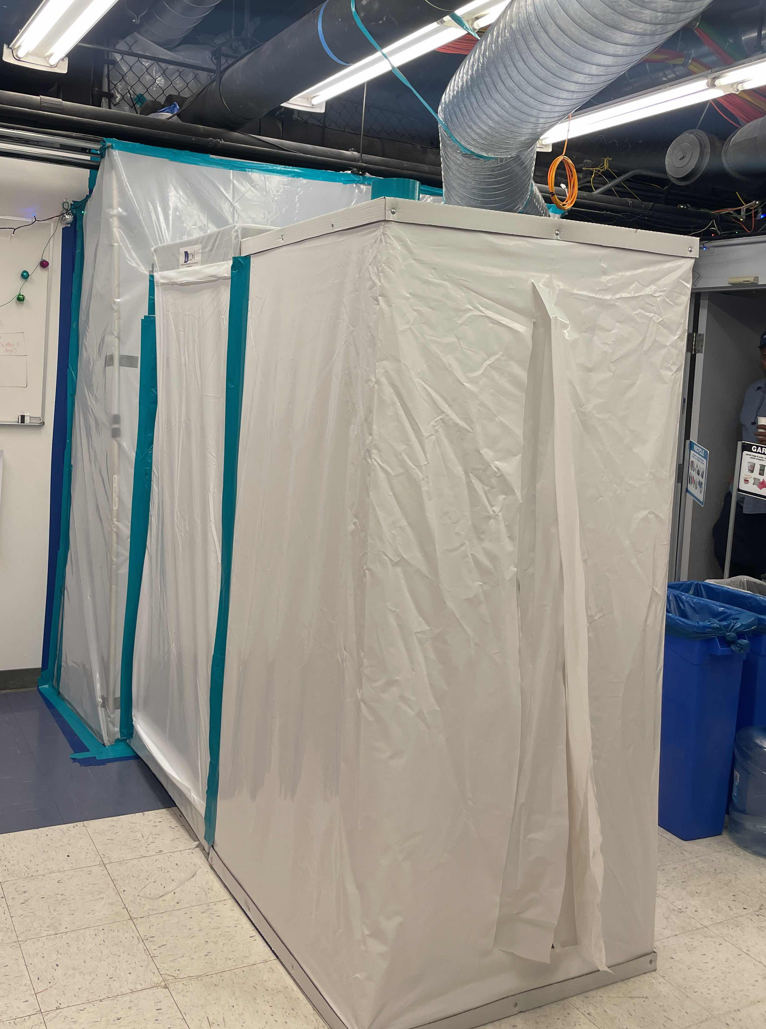
Interior Seismic Bracing in Asbestos Containing Material(ACM)
High Impact Activity - To safely install bracing in existing system, there is a need to setup containments, so the pollutants(if any) are trapped and cleaned before released to the exterior. Containments will be spread across the floor that will impact some offices and UCSF will help occupants to relocate.
Notes:
Change the layout to a floor that’s not classroom
HSW15 - use a medium or difficult floor.

Slide 14
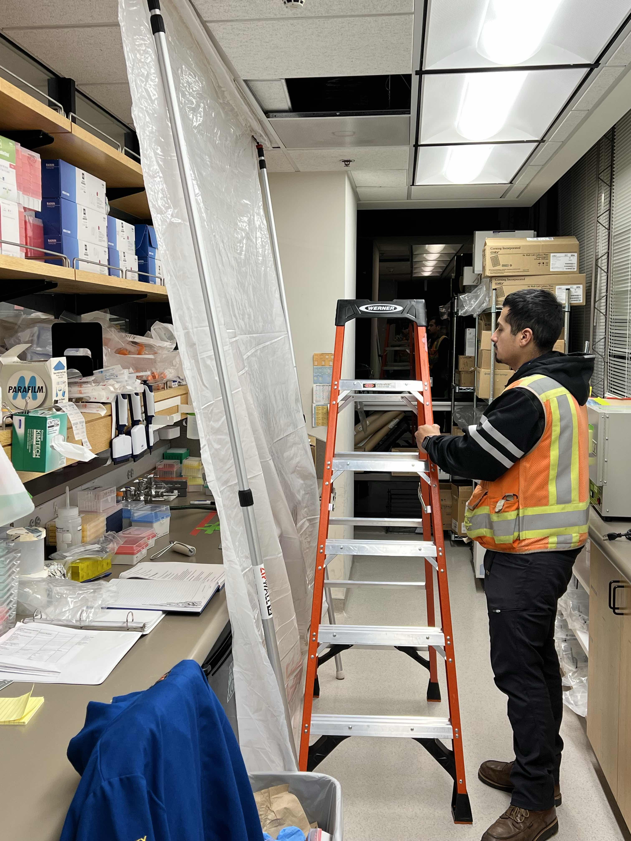
Dust & Tool Control for Bracing Work
Section 1
Section 2
Protecting Area before Work

Slide 15
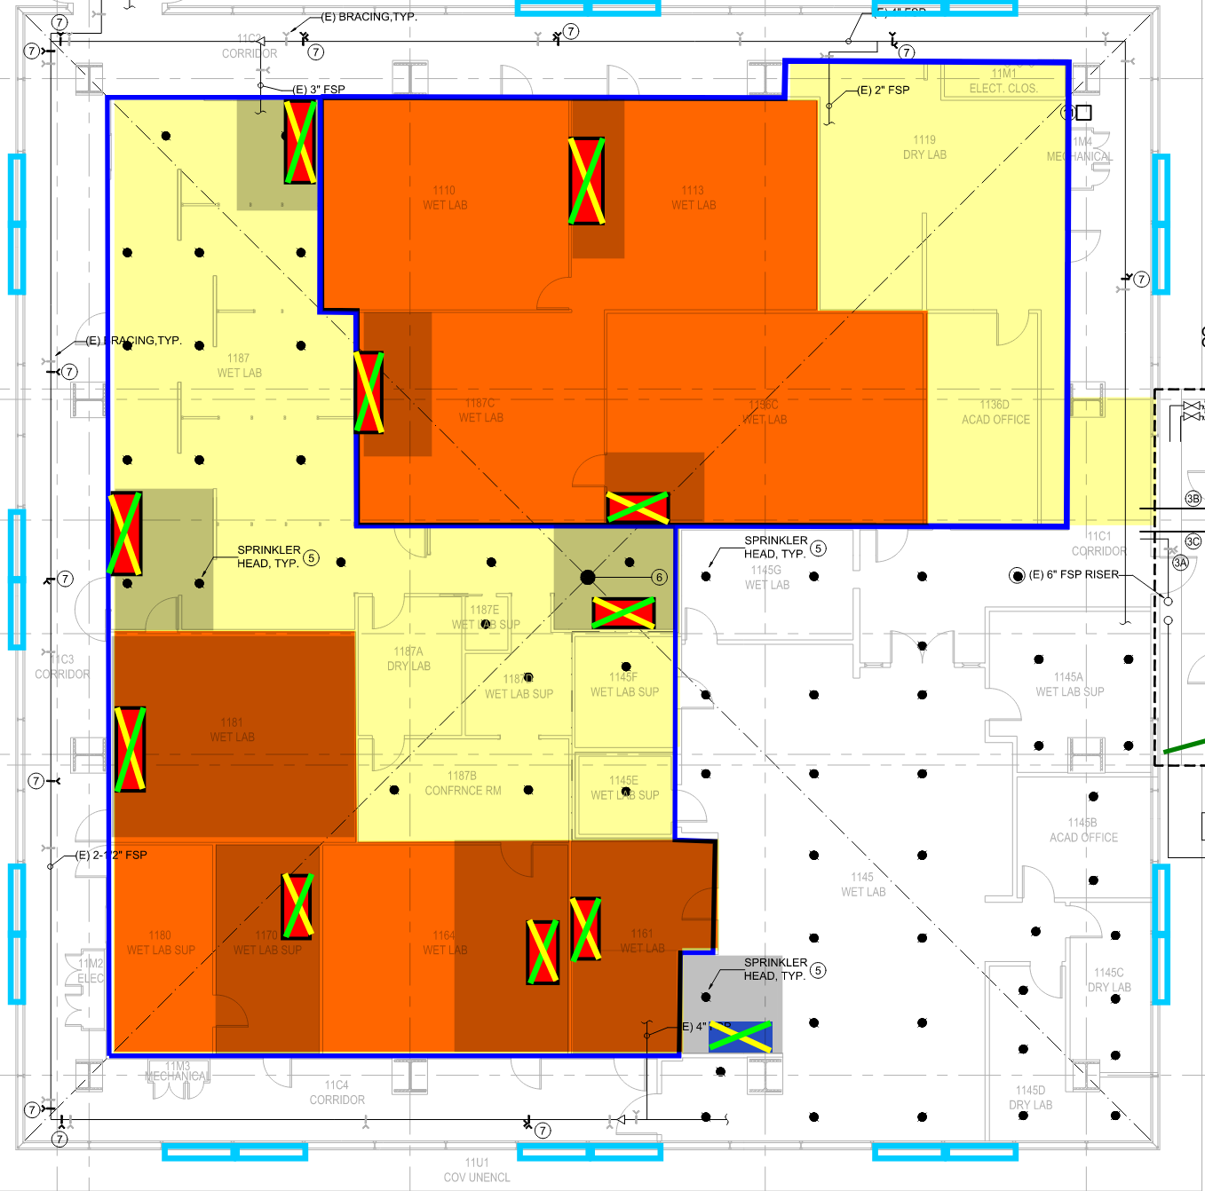
Fire Sprinkler Installation
Larger containments than seismic bracing work
Typically, Webcor would take over the entire section at once to finish the installation smoothly and efficiently
However, Webcor/UCSF team will work with the occupants to reasonably accommodate their requests
Section 1
Section 2
High Impact Activity - Some portions of the buildings are not fully sprinklered yet and an objective of the project is to have a fully sprinklered building. To efficiently and quickly install sprinkler system, there is a need to take over the space at once.
If ACM is contained in the space where new sprinklers are needed, containments are to be setup as well.

Slide 16
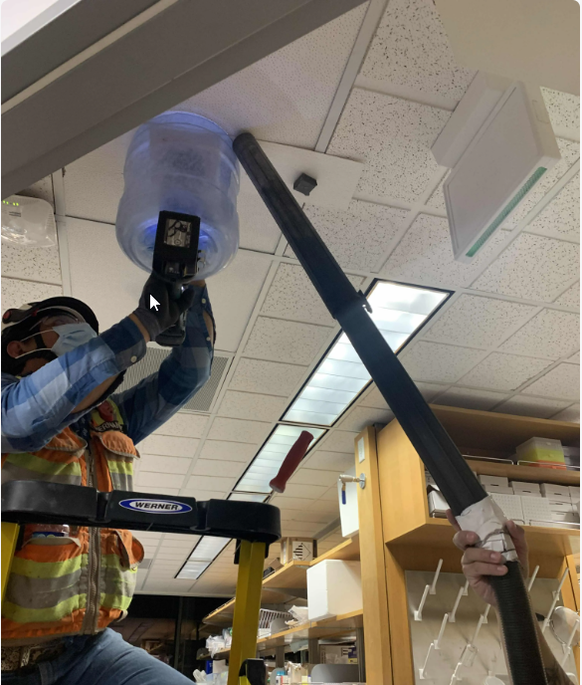
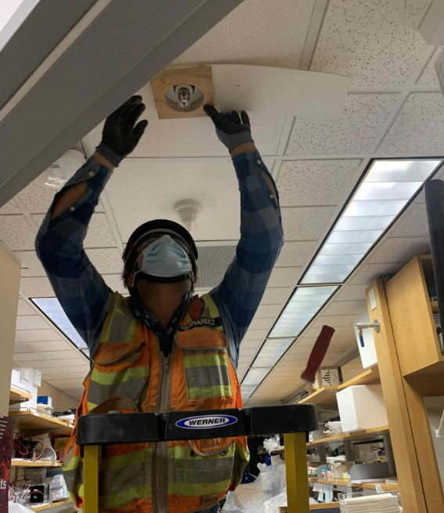
Existing Escutcheon Oversizing
Section 1
Section 2
Oversizing of Escutcheon

Slide 17
Coordination with Occupants
Pre-Investigation Walks Complete
1 week prior to investigation with the key occupants
Purpose is to identify the sensitive areas
Pre-Construction Meetings & Walks
2-3 weeks prior to construction, Webcor/UCSF to send out pre-construction notifications
1-2 weeks prior to construction, Webcor/UCSF to have walk with the key occupants
Post-Construction Walks
Turnover of space back to occupants
In case of questions, please reach out to HSIR-Improvements-Program@ucsf.edu
or visit https://realestate.ucsf.edu/construction-updates

Slide 18
Questions?

